Slide 1
Smart City Automation System
Md. Amimul Basher
011161075
Md. Ahsan Habib Shuvo
011161068
Julker Nien Akib
011142157

Slide 2
Project Features
Smart office management
Smart fire alarm
Smart power management
Smart environment control
Smart violation control
Smart home security

Slide 3
Smart office management
Sensors:
Fire Detector
Smoke Sensor
Wind Sensor
Temperature Sensor

Slide 4
Smart office management
Actuator:
Celling Sprinkler
Heating Element
IOT Elements :
AC
Furnace
Door
Webcam
Light
Battery
Solar
Fan
Coffee Maker

Slide 5
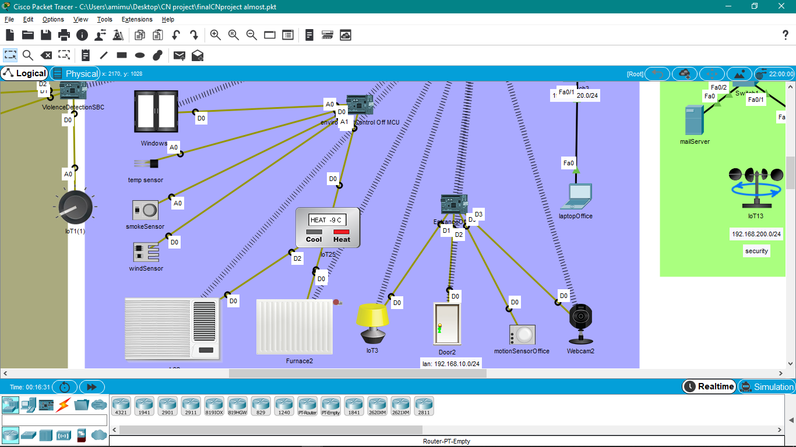
Smart office management

Slide 6
Smart fire alarm
IOT Components :
SBC
Fire Detector
Smoke Sensor
Heating Element
Siren

Slide 7
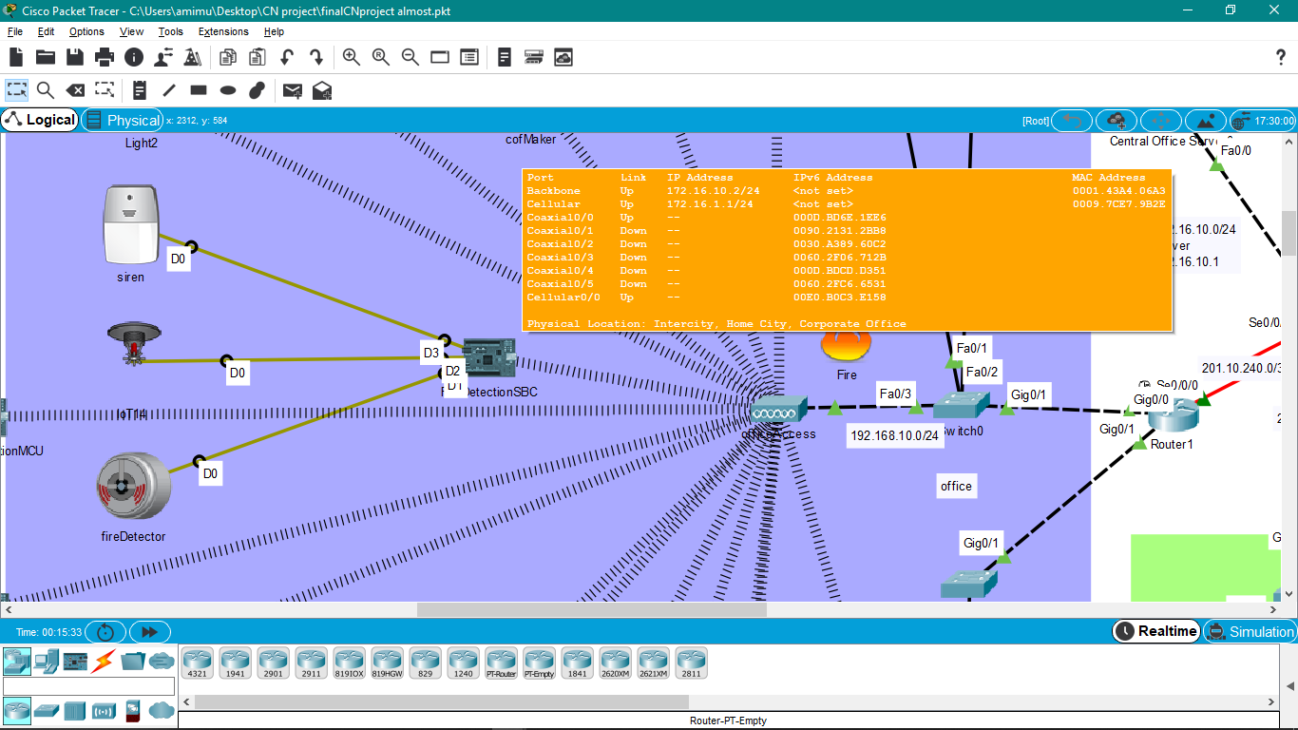
Smart fire alarm

Slide 8
Smart environment control
IOT Components:
Fire Detector
MCU
AC
Furnace
Window
Thermostat
Smoke Sensor
Wind Sensor
Temperature Sensor

Slide 9
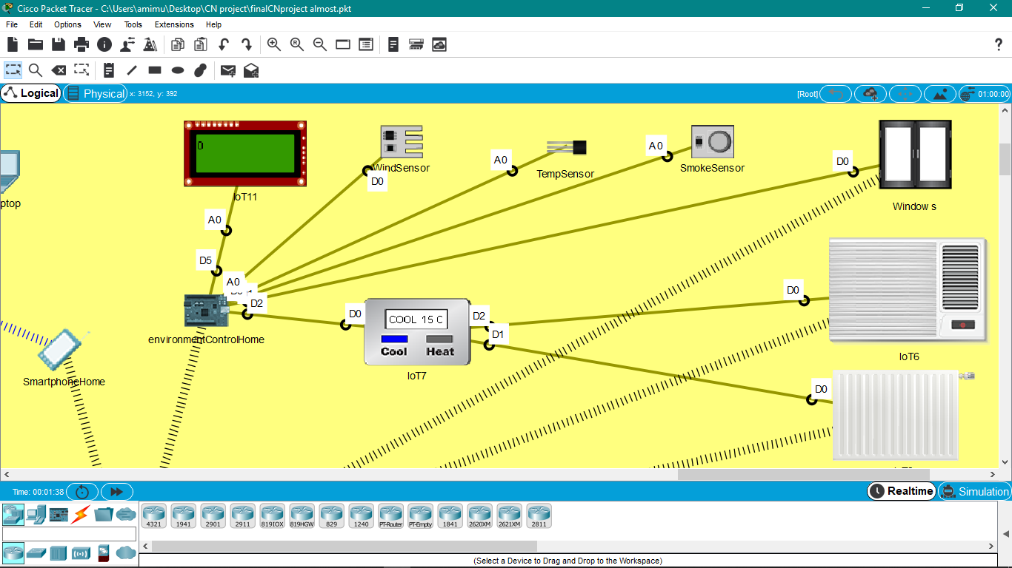
Smart environment control

Slide 10
Smart power management
IOT Components:
MCU
Fan
Lamp Light
Solar
Battery

Slide 11
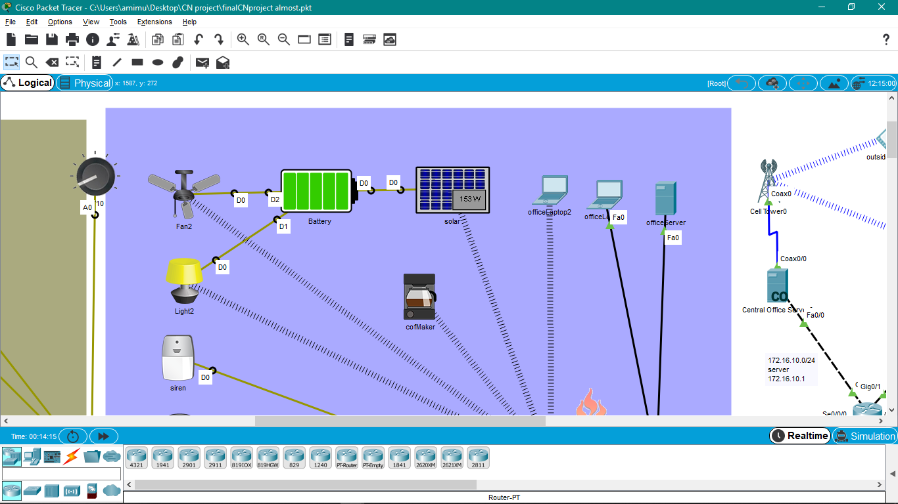
Smart power management

Slide 12
Smart violation control
IOT Components:
MCU
Sound Detector
Potentiometer
Home Sound

Slide 13
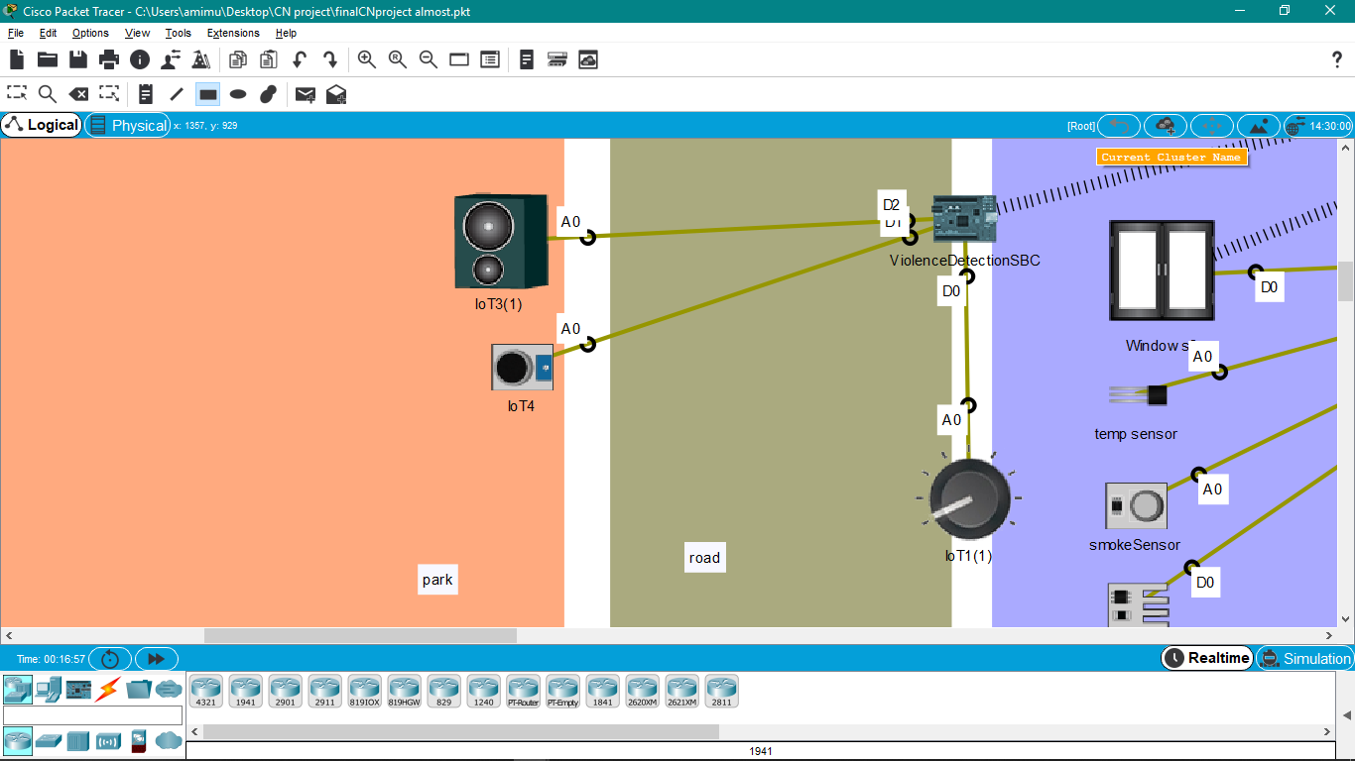
Smart violation control

Slide 14
Smart home security
IOT Components:
MCU
Motion Sensor
Fan
Lamp Light
Webcam

Slide 15
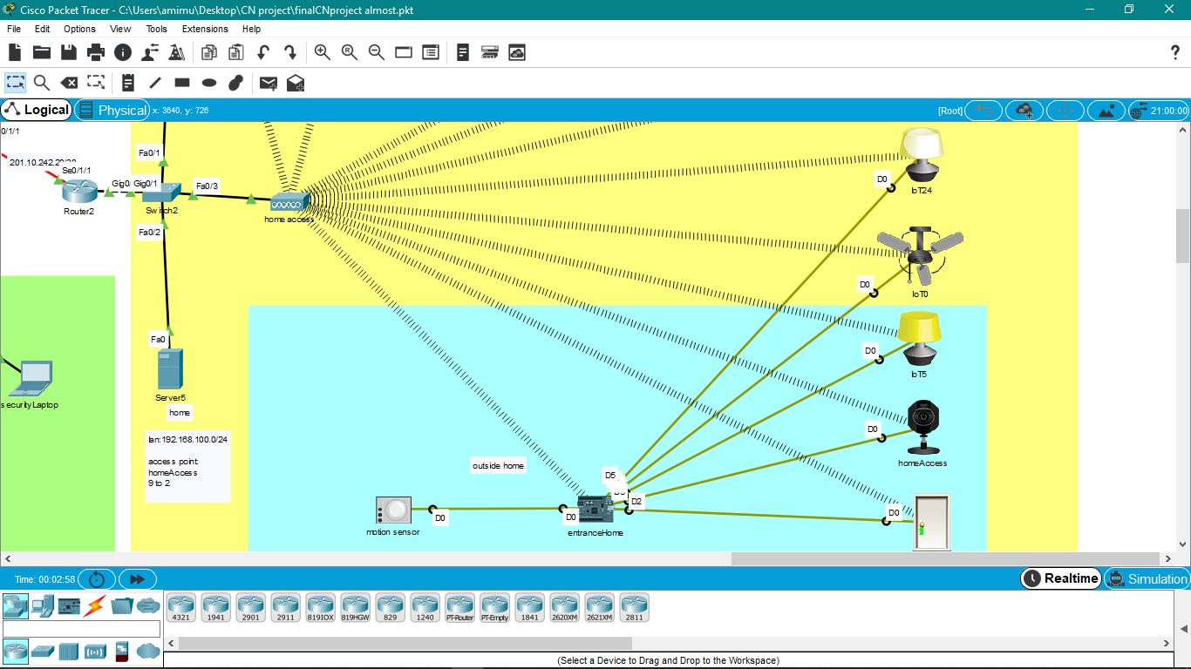
Smart home security

Slide 16
The end
THANK YOU ! ! !

